Slide 1
Chapter 3
Simple Regression Analysis
(Part 2)
Terry Dielman
Applied Regression Analysis:
A Second Course in Business and Economic Statistics, fourth edition
Simple Regression II
Copyright © 2005 Brooks/Cole, a division of Thomson Learning, Inc.

Slide 2
3.4 Assessing the Fit of the Regression Line
It some problems, it may not be possible to find a good predictor of the y values.
We know the least squares procedure finds the best possible fit, but that des not guarantee good predictive power.
In this section we discuss some methods for summarizing the fit quality.
Simple Regression II
Copyright © 2005 Brooks/Cole, a division of Thomson Learning, Inc.

Slide 3
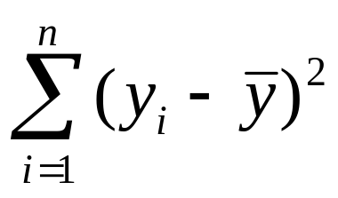
3.4.1 The ANOVA Table
Let us start by looking at the amount of variation in the y values. The variation about the mean is:
which we will call SST, the total sum of squares.
Text equations (3.14) and (3.15) show how this can be split up into two parts.
Simple Regression II
Copyright © 2005 Brooks/Cole, a division of Thomson Learning, Inc.

Slide 4
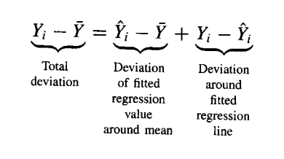
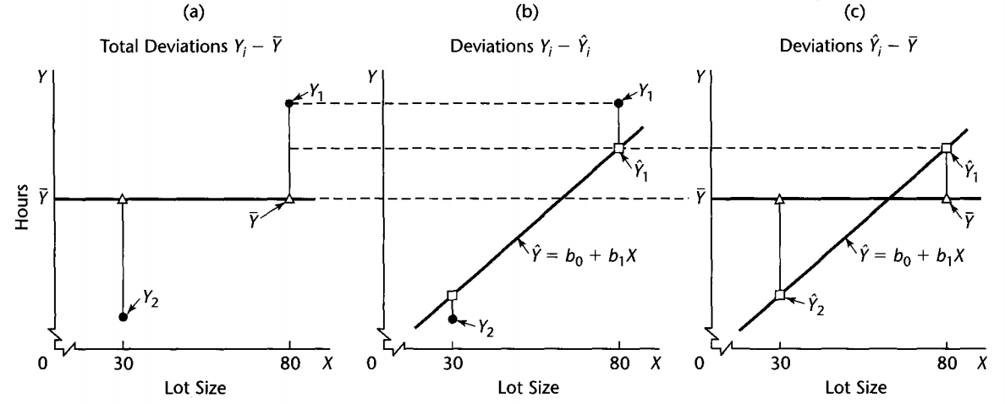
Simple Regression II
Copyright © 2005 Brooks/Cole, a division of Thomson Learning, Inc.

Slide 5
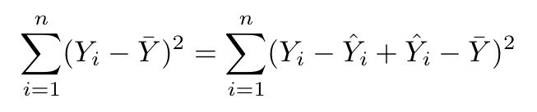
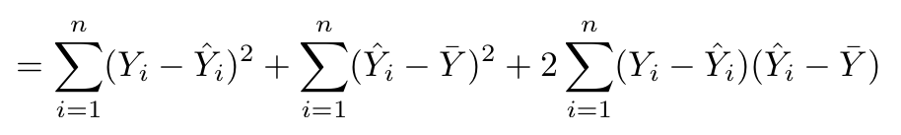
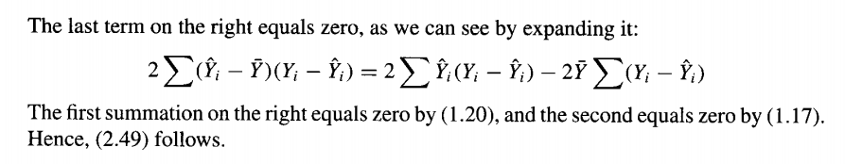
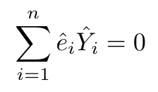
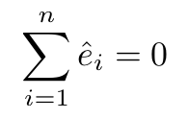
Simple Regression II
Copyright © 2005 Brooks/Cole, a division of Thomson Learning, Inc.

Slide 6
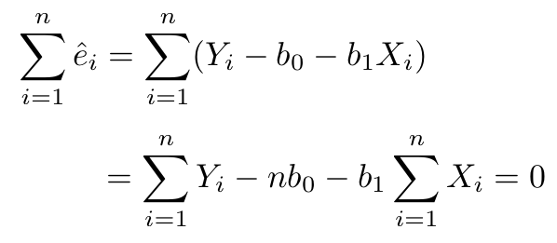
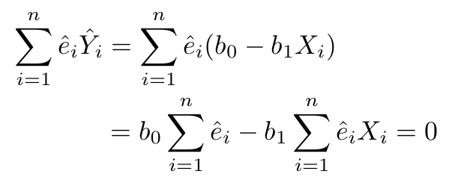
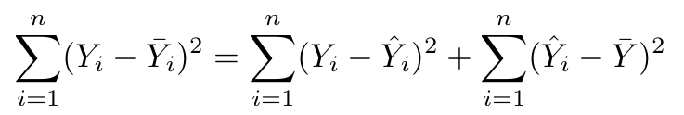
Simple Regression II
Copyright © 2005 Brooks/Cole, a division of Thomson Learning, Inc.

Slide 7
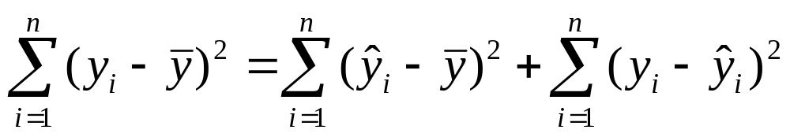
Partitioning SST
SST can be split into two pieces which are the previously introduced SSE and a new quantity, SSR, the regression sum of squares.
SST = SSR + SSE
Simple Regression II
Copyright © 2005 Brooks/Cole, a division of Thomson Learning, Inc.

Slide 8
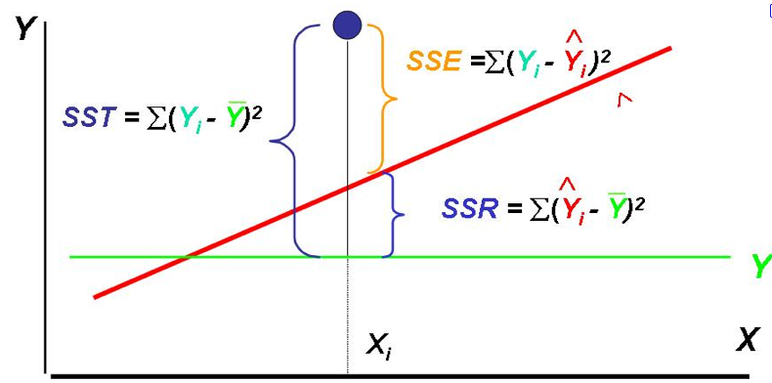
SST=SSR+SSE
Simple Regression II
Copyright © 2005 Brooks/Cole, a division of Thomson Learning, Inc.

Slide 9
Explained and Unexplained Variation
We know that SSE is the sum of all the squared residuals, which represent lack of fit in the observations.
We call this the unexplained variation in the sample.
Because SSR contains the remainder of the variation in the sample, it is thus the variation explained by the regression equation.
Simple Regression II
Copyright © 2005 Brooks/Cole, a division of Thomson Learning, Inc.

Slide 10
The ANOVA Table
Most statistics packages organize these quantities in an ANalysis Of VAriance table.
Source | DF | SS | MS | F
Regression | 1 | SSR | MSR | MSR/MSE
Residual | n-2 | SSE | MSE
Total | n-1 | SST
Simple Regression II
Copyright © 2005 Brooks/Cole, a division of Thomson Learning, Inc.

Slide 11
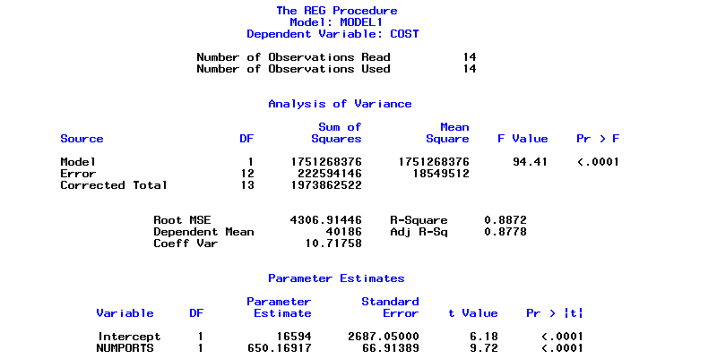
SAS output
Simple Regression II
Copyright © 2005 Brooks/Cole, a division of Thomson Learning, Inc.

Slide 12
3.4.2 The Coefficient of Determination
If we had an exact relationship between y and x, then SSE would be zero and SSR = SST.
Since that does not happen often it is convenient to use the ratio of SSR to SST as measure of how close we get to the exact relationship.
This ratio is called the Coefficient of Determination or R².
Simple Regression II
Copyright © 2005 Brooks/Cole, a division of Thomson Learning, Inc.

Slide 13
R²
SSR
R² = —— is a fraction between 0 and 1
SST
In an exact model, R² would be 1. Most of the time we multiply by 100 and report it as a percentage.
Thus, R² is the percentage of the variation in the sample of y values that is explained by the regression equation.
Simple Regression II
Copyright © 2005 Brooks/Cole, a division of Thomson Learning, Inc.

Slide 14
SAS output
Simple Regression II
Copyright © 2005 Brooks/Cole, a division of Thomson Learning, Inc.

Slide 15
Correlation Coefficient
Some programs also report the square root of R² as the correlation between the y and y-hat values.
When there is only a single predictor variable, as here, the R² is just the square of the correlation between y and x. (proof)
Simple Regression II
Copyright © 2005 Brooks/Cole, a division of Thomson Learning, Inc.

Slide 16


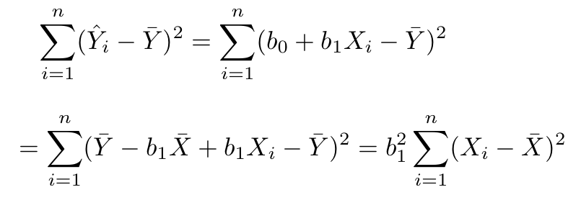
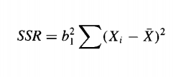
Simple Regression II
Copyright © 2005 Brooks/Cole, a division of Thomson Learning, Inc.

Slide 17
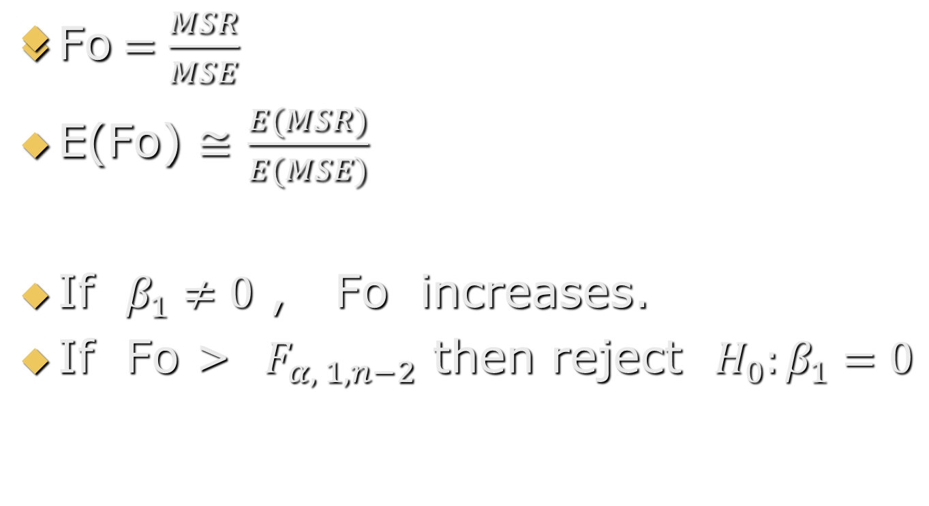
Why do we need F value ?
Simple Regression II
Copyright © 2005 Brooks/Cole, a division of Thomson Learning, Inc.

Slide 18
3.4.3 The F Test
An additional measure of fit is provided by the F statistic, which is the ratio of MSR to MSE.
This can be used as another way to test the hypothesis that β₁ = 0.
This test is not real important in simple regression because it is redundant with the t test on the slope.
In multiple regression (next chapter) it is much more important.
Simple Regression II
Copyright © 2005 Brooks/Cole, a division of Thomson Learning, Inc.

Slide 19
F Test Setup
The hypotheses are:
  H₀: β₁ = 0
  H_{a}: β₁ ≠ 0
The F ratio has 1 numerator degree of freedom and n-2 denominator degrees of freedom.
A critical value for the test is selected from that distribution and H₀ is rejected if the computed F ratio exceeds the critical value.
Simple Regression II
Copyright © 2005 Brooks/Cole, a division of Thomson Learning, Inc.

Slide 20
Example 3.8 Pricing Communications Nodes (continued)
Below we see the portion of the Minitab output that lists the statistics we have just discussed.
S = 4307 R-Sq = 88.7% R-Sq(adj) = 87.8%
Analysis of Variance
Source DF SS MS F P
Regression 1 1751268376 1751268376 94.41 0.000
Residual Error 12 222594146 18549512
Total 13 1973862521
Simple Regression II
Copyright © 2005 Brooks/Cole, a division of Thomson Learning, Inc.

Slide 21
SAS output
Simple Regression II
Copyright © 2005 Brooks/Cole, a division of Thomson Learning, Inc.

Slide 22
R² and F
R² = SSR/SST = 1751268376/ 1973862521
= .8872 or 88.7%
F = MSR/MSE = 1751268376/222594146
= 94.41
From the F_{1,12} distribution, the critical value at a 5% significance level is 4.75
Simple Regression II
Copyright © 2005 Brooks/Cole, a division of Thomson Learning, Inc.

Slide 23
3.5 Prediction or Forecasting With a Simple Linear Regression Equation
Suppose we are interested in predicting the cost of a new communications node that had 40 ports.
If this size project is something we would see often, we might be interested in estimating the average cost of all projects with 40 nodes.
If it was something we expect to see only once, we would be interested in predicting the cost of the individual project.
Simple Regression II
Copyright © 2005 Brooks/Cole, a division of Thomson Learning, Inc.

Slide 24
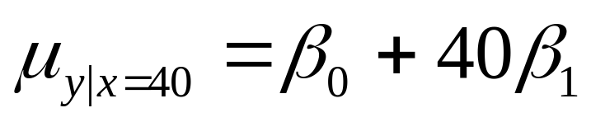
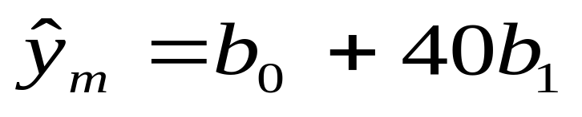
3.5.1 Estimating the Conditional Mean of y Given x.
At x_{m} = 40 ports, the quantity we are estimating is:
Our best guess of this is just the point on the regression line:
Simple Regression II
Copyright © 2005 Brooks/Cole, a division of Thomson Learning, Inc.

Slide 25
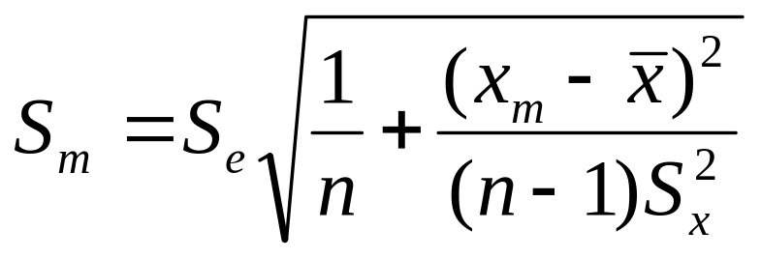
Standard Error of the Mean
We will want to make an interval estimate, so we need some kind of standard error.
Because our point estimate is a function of the random variables b₀ and b₁ their standard errors figure into our computation.
The result is:
Simple Regression II
Copyright © 2005 Brooks/Cole, a division of Thomson Learning, Inc.

Slide 26
Where Are We Most Accurate?
For estimating the mean at the point x_{m} the standard error is S_{m}.
If you examine the formula:
you can see that the second term will be zero if we predict at the mean value of x.
That makes sense—it says you do your best prediction right in the center of your data.
Simple Regression II
Copyright © 2005 Brooks/Cole, a division of Thomson Learning, Inc.

Slide 27
Interval Estimate
For estimating the conditional mean of y that occurs at x_{m} we use:
^
y_{m} ± t_{n-2} S_{m}
We call this a confidence interval for the mean value of y at x_{m}.
Simple Regression II
Copyright © 2005 Brooks/Cole, a division of Thomson Learning, Inc.

Slide 28
Hypothesis Test
We could also perform a hypothesis test about the conditional mean.
The hypothesis would be:
H₀: µ_{y|x=40} = (some value)
and we would construct a t ratio from the point estimate and standard error.
Simple Regression II
Copyright © 2005 Brooks/Cole, a division of Thomson Learning, Inc.

Slide 29
3.5.2 Predicting an Individual Value of y Given x
If we are trying to say something about an individual value of y it is a little bit harder.
We not only have to first estimate the conditional mean, but we also have to tack on an allowance for y being above or below its mean.
We use the same point estimate but our standard error is larger.
Simple Regression II
Copyright © 2005 Brooks/Cole, a division of Thomson Learning, Inc.

Slide 30
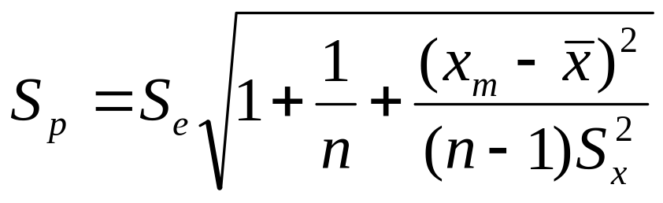
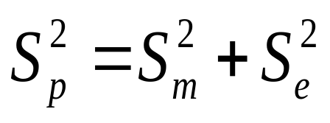
Prediction Standard Error
It can be show that the prediction standard error is:
This looks a lot like the previous one but has an additional term under he square root sign.
The relationship is:
Simple Regression II
Copyright © 2005 Brooks/Cole, a division of Thomson Learning, Inc.

Slide 31
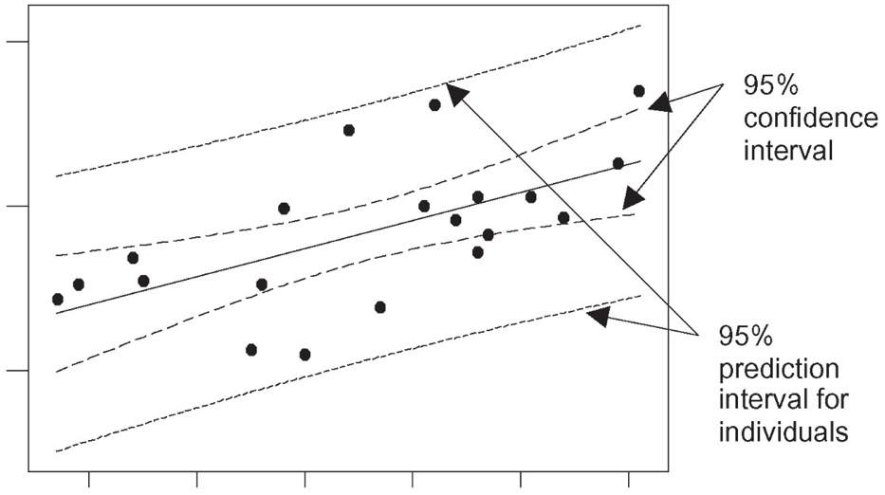
C.I. vs P.I.
Simple Regression II
Copyright © 2005 Brooks/Cole, a division of Thomson Learning, Inc.

Slide 32
Predictive Inference
Although we could be interested in a hypothesis test, the most common type of predictive inference is a prediction interval.
The interval is just like the one for the conditional mean, except that S_{p} is used in the computation.
Simple Regression II
Copyright © 2005 Brooks/Cole, a division of Thomson Learning, Inc.

Slide 33
Example 3.10 Pricing Communications Nodes (one last time)
What do we get when there are 40 ports?
Many statistics packages have a way for you to do the prediction. Here is Minitab's output:
Predicted Values for New Observations
New Obs Fit SE Fit 95.0% CI 95.0% PI
1 42600 1178 ( 40035, 45166) ( 32872, 52329)
Values of Predictors for New Observations
New Obs NUMPORTS
1 40.0
Simple Regression II
Copyright © 2005 Brooks/Cole, a division of Thomson Learning, Inc.

Slide 34
P.I. in SAS
data c;
input cost numports; cards;
. 40
. 68
;
data total; set b c;
proc reg data=total;
model cost=numports;
output out=predict p=y_pred LCL=cost_95LCL UCL=cost_95UCL
LCLM=ecost_95LCL UCLM=ecost_95UCL;
proc print data=predict(where=(cost=.)) noobs;
run;
Simple Regression II
Copyright © 2005 Brooks/Cole, a division of Thomson Learning, Inc.

Slide 35

SAS output (P.I.)
Simple Regression II
Copyright © 2005 Brooks/Cole, a division of Thomson Learning, Inc.

Slide 36
From the Output
^
y_{m} = 42600 S_{m} = 1178
Confidence interval: 40035 to 45166
computed: 42600 ± 2.179(1178)
Prediction interval: 32872 to 52329
computed: 42600 ± 2.179(????)
it does not list S_{p}
Simple Regression II
Copyright © 2005 Brooks/Cole, a division of Thomson Learning, Inc.

Slide 37
Interpretations
For all projects with 40 nodes, we are 95% sure that the average cost is between $40,035 and $45,166.
We are 95% sure that any individual project will have a cost between $32,872 and $52,329.
Simple Regression II
Copyright © 2005 Brooks/Cole, a division of Thomson Learning, Inc.

Slide 38
3.5.3 Assessing Quality of Prediction
We use the model's R² as a measure of fit ability, but this may overestimate the model's ability to predict.
The reason for that is that R² is optimized by the least squares procedure, for the data in our sample.
It is not necessarily optimal for data outside our sample, which is what we are predicting.
Simple Regression II
Copyright © 2005 Brooks/Cole, a division of Thomson Learning, Inc.

Slide 39
Data Splitting
We can split the data into two pieces. Use the first part to obtain the equation and use it to predict the data in the second part.
By comparing the actual y values in the second part to their corresponding predicted values, you get an idea of how well you predict data that is not in the "fit" sample.
The biggest drawback to this is that it won't work too well unless we have a lot of data. To be really reliable we should have at least 25 to 30 observations in both samples.
Simple Regression II
Copyright © 2005 Brooks/Cole, a division of Thomson Learning, Inc.

Slide 40
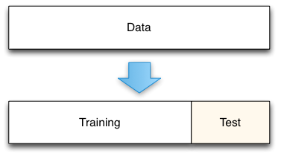
Data Splitting
Simple Regression II
Copyright © 2005 Brooks/Cole, a division of Thomson Learning, Inc.

Slide 41
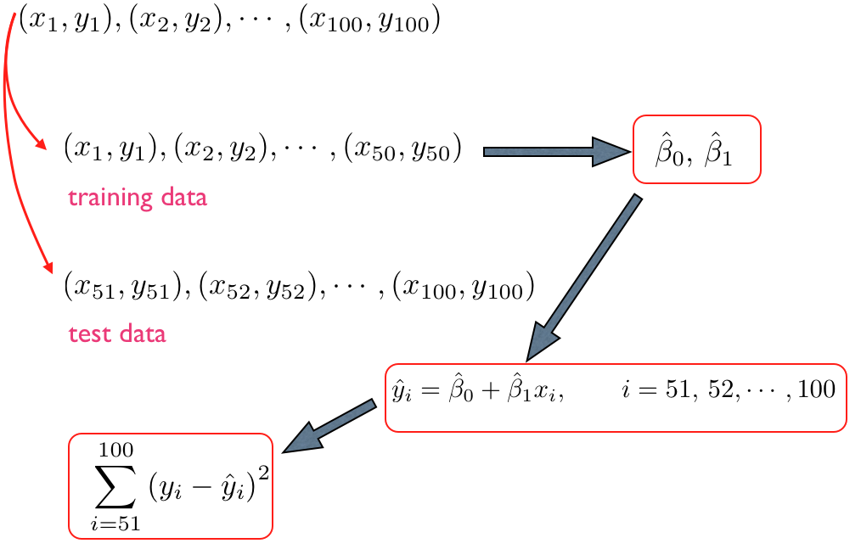
Simple Regression II
Copyright © 2005 Brooks/Cole, a division of Thomson Learning, Inc.

Slide 42
The PRESS Statistic
Suppose you temporarily deleted observation i from the data set, fit a new equation, then used it to predict the y_{i} value.
Because the new equation did not use any information from this data point, we get a clearer picture of the model's ability to predict it.
The sum of these squared prediction errors is the PRESS statistic.
Simple Regression II
Copyright © 2005 Brooks/Cole, a division of Thomson Learning, Inc.

Slide 43
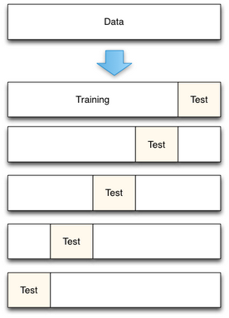
PRESS
Simple Regression II
Copyright © 2005 Brooks/Cole, a division of Thomson Learning, Inc.

Slide 44
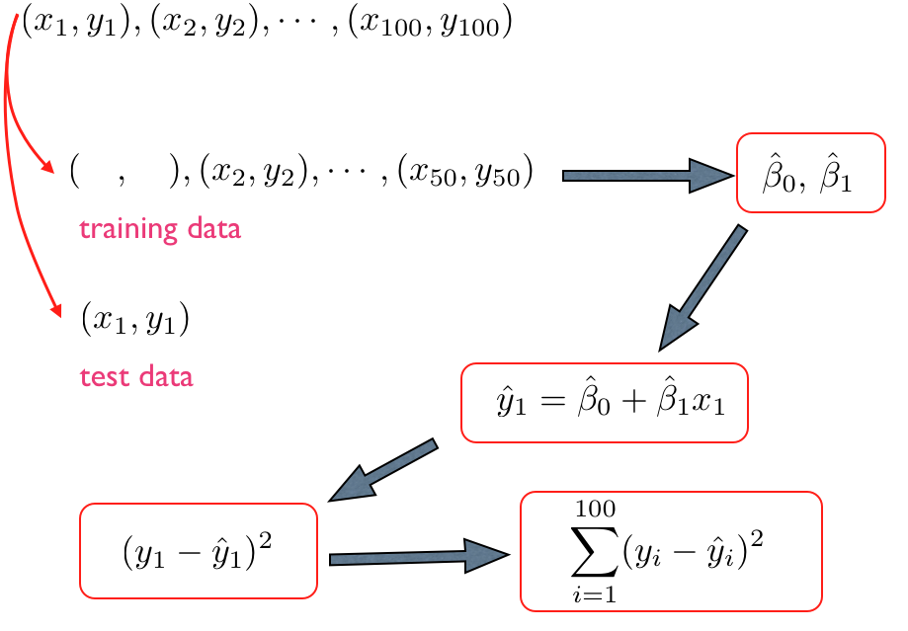
Simple Regression II
Copyright © 2005 Brooks/Cole, a division of Thomson Learning, Inc.

Slide 45

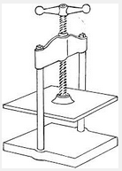
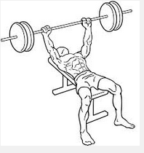

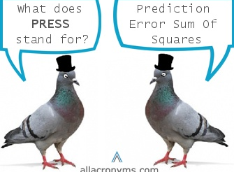
Simple Regression II
Copyright © 2005 Brooks/Cole, a division of Thomson Learning, Inc.

Slide 46
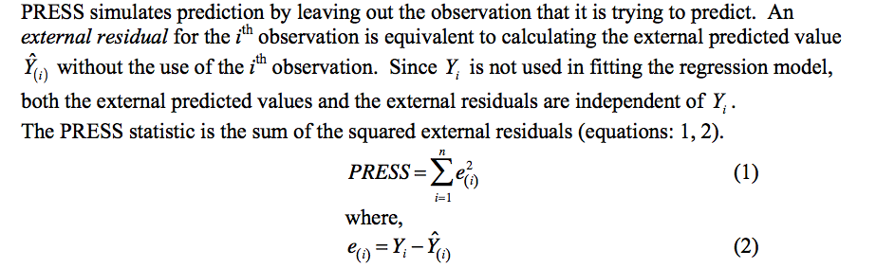
PRESS
Prediction Residual Sum of Squares
proc reg data=a outest=esta PRESS;
model cost=numports; run;
proc print data=esta; run;
Simple Regression II
Copyright © 2005 Brooks/Cole, a division of Thomson Learning, Inc.

Slide 47
SAS ouput
Simple Regression II
Copyright © 2005 Brooks/Cole, a division of Thomson Learning, Inc.

Slide 48
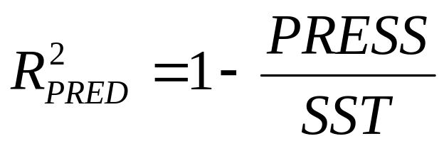
Prediction R²
It sounds like a lot of work to do by hand, but most statistics packages will do it for you.
You can then compute an R²-like measure called the prediction R²:
Simple Regression II
Copyright © 2005 Brooks/Cole, a division of Thomson Learning, Inc.

Slide 49
In Our Example
For the communications node data we have been using, SSE = 222594146, SST =1973862521 and R² = 88.7%
Minitab reports that PRESS = 345066019
Our prediction R^{2:}
1 – (345066019/1973862521) = 1 - .175 = .825 or 82.5%
Although there is a little loss, it implies we still have good prediction ability.
Simple Regression II
Copyright © 2005 Brooks/Cole, a division of Thomson Learning, Inc.

Slide 50
3.6 Fitting a Linear Trend Model to Time-Series Data
Data gathered on different units at the same point in time are called cross sectional data.
Data gathered on a single unit (person, firm, etc.) over a sequence of time periods are called time-series data.
With this type of data, the primary goal is often building a model that can forecast the future
Simple Regression II
Copyright © 2005 Brooks/Cole, a division of Thomson Learning, Inc.

Slide 51
Time Series Models
There are many types of models that attempt to identify patterns of behavior in a time series in order to extrapolate it into the future.
Some of these will be examined in Chapter 11, but here we will just employ a simple linear trend model.
Simple Regression II
Copyright © 2005 Brooks/Cole, a division of Thomson Learning, Inc.

Slide 52
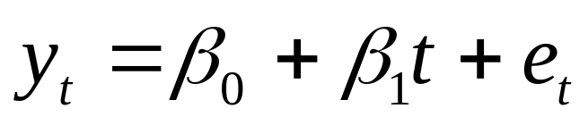
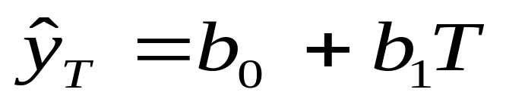
The Linear Trend Model
We assume the series displays a steady upward or downward behavior over time that can be described by:
where t is the time index (t =1 for the first observation, t=2 for the second, and so forth).
The forecast for this model is quite simple:
You just insert the appropriate value for T into the regression equation.
Simple Regression II
Copyright © 2005 Brooks/Cole, a division of Thomson Learning, Inc.

Slide 53
Example 3.11 ABX Company Sales
The ABX Company sells winter sports merchandise including skates and skis. The quarterly sales (in $1000s) from first quarter 1994 through fourth quarter 2003 are graphed on the next slide.
The time-series plot shows a strong upward trend. There are also some seasonal fluctuations which will be addressed in Chapter 7.
Simple Regression II
Copyright © 2005 Brooks/Cole, a division of Thomson Learning, Inc.

Slide 54
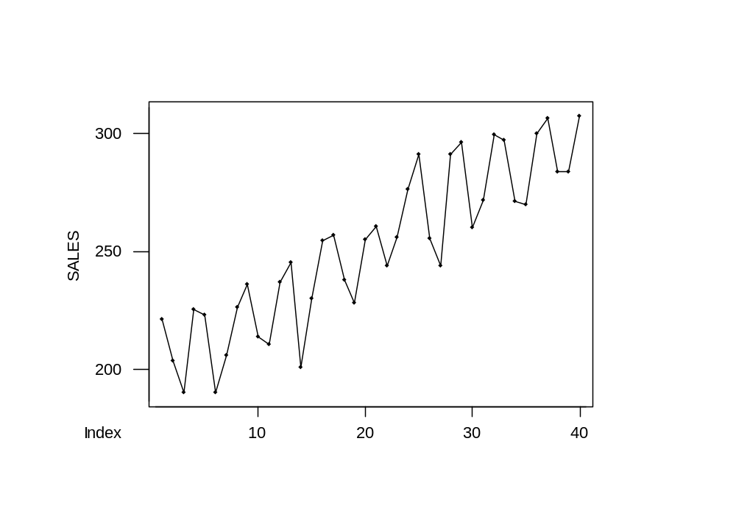
ABX Company Sales
Simple Regression II
Copyright © 2005 Brooks/Cole, a division of Thomson Learning, Inc.

Slide 55
Obtaining the Trend Equation
We first need to create the time index variable which is equal to 1 for first quarter 1994 and 40 for fourth quarter 2003.
Once this is created we can obtain the trend equation by linear regression.
Simple Regression II
Copyright © 2005 Brooks/Cole, a division of Thomson Learning, Inc.

Slide 56
Trend Line Estimation
The regression equation is
SALES = 199 + 2.56 TIME
Predictor Coef SE Coef T P
Constant 199.017 5.128 38.81 0.000
TIME 2.5559 0.2180 11.73 0.000
S = 15.91 R-Sq = 78.3% R-Sq(adj) = 77.8%
Analysis of Variance
Source DF SS MS F P
Regression 1 34818 34818 137.50 0.000
Residual Error 38 9622 253
Total 39 44440
Simple Regression II
Copyright © 2005 Brooks/Cole, a division of Thomson Learning, Inc.

Slide 57
The Slope Coefficient
The slope in the equation is 2.5559. This implies that over this 10-year period, we saw an average growth in sales of $2,556 per quarter.
The hypothesis test on the slope has a t value of 11.73, so this is indeed significantly greater than zero.
Simple Regression II
Copyright © 2005 Brooks/Cole, a division of Thomson Learning, Inc.

Slide 58
Forecasts For 2004
Forecasts for 2004 can be obtained by evaluating the equation at t = 41, 42, 43 and 44.
For example, the sales in fourth quarter are forecast:
SALES = 199 + 2.56 (44) = 311.48
A graph of the data, the estimated trend and the forecasts is next.
Simple Regression II
Copyright © 2005 Brooks/Cole, a division of Thomson Learning, Inc.

Slide 59
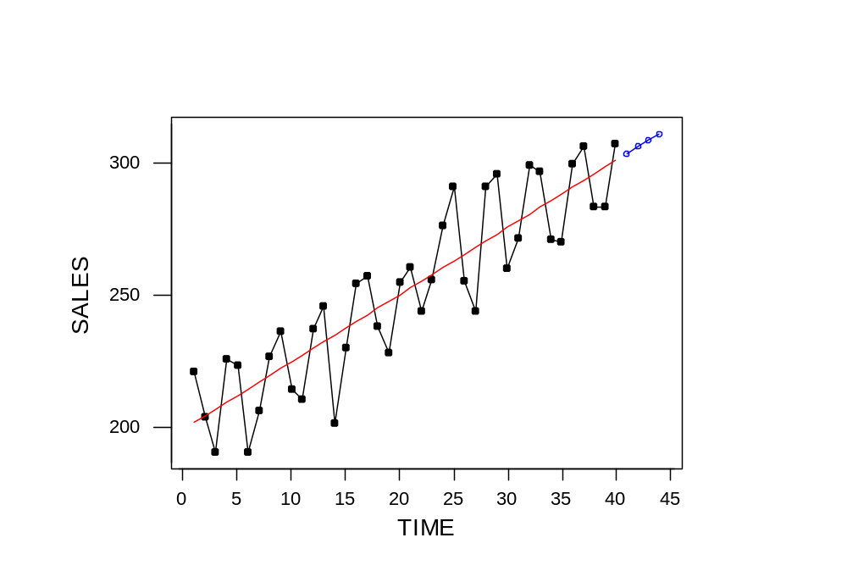
Data, Trend (—) and Forecast (---)
Simple Regression II
Copyright © 2005 Brooks/Cole, a division of Thomson Learning, Inc.

Slide 60
3.7 Some Cautions in Interpreting Regression Results
Two common mistakes that are made when using regression analysis are:
  That x causes y to happen, and
  That you can use the equation to predict y for any value of x.
Simple Regression II
Copyright © 2005 Brooks/Cole, a division of Thomson Learning, Inc.

Slide 61
3.7.1 Association Versus Causality
If you have a model with a high R², it does not automatically mean that a change in x causes y to change in a very predictable way.
It could be just the opposite, that y causes x to change. A high correlation goes both ways.
It could also be that both y and x are changing in response to a third variable that we don't know about.
Simple Regression II
Copyright © 2005 Brooks/Cole, a division of Thomson Learning, Inc.

Slide 62
The Third Factor
One example of this third factor is the price and gasoline mileage of automobiles. As price increases, there is a sharp drop in mpg. This is caused by size. Larger cars cost more and get less mileage.
Another is mortality rate in a country versus percentage of homes with television. As TV ownership increases, mortality rate drops. This is probably due to better economic conditions improving quality of life and simultaneously allowing for greater ownership.
Simple Regression II
Copyright © 2005 Brooks/Cole, a division of Thomson Learning, Inc.

Slide 63
3.7.2 Forecasting Outside the Range of the Explanatory Variable
When we have a model with a high R², it means we know a good deal about the relationship of y and x for the range of x values in our study.
Think of our communication nodes example where number of ports ranged from 12 to 68. Does our model even hold if we wanted to price a massive project of 200 ports?
Simple Regression II
Copyright © 2005 Brooks/Cole, a division of Thomson Learning, Inc.

Slide 64
An Extrapolation Penalty
Recall that our prediction intervals were always narrowest when we predicted right in the middle of our data set.
As we go farther and farther outside the range of our data, the interval gets wider and wider, implying we know less and less about what is going on.
Simple Regression II
Copyright © 2005 Brooks/Cole, a division of Thomson Learning, Inc.

